Slide 1

TENNESSEE ALCOHOLIC BEVERAGE COMMISSION
How to Read a COA: Ensuring the Products You Sell Are Legal in Tennessee

Slide 2
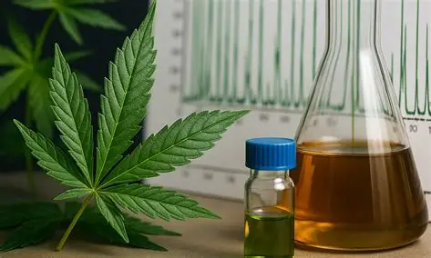
Overview
What is a COA & QR Code
Why Does Testing Matter
Who issues a COA
Types of HDCPs that require a COA
Information required to be listed on a COA
Ensuring the COA is compliant for the HDCP
Suspicious cases of non-compliant COAs
2025 TABC Webinar How to Read a COA

Slide 3
What is a COA & Why Does Testing Matter
A COA is a Certificate of Analysis that provides testing results and contains easily accessible information related to specific testing results for the HDCP.
A report of all QA measures a HDCP has been tested for.
In today's highly regulated and consumer-aware markets, simply stating that a product is safe is not sufficient.
Validates a product's quality and compliance with regulatory standards, offering transparency and building essential trust
2025 TABC Webinar How to Read a COA

Slide 4
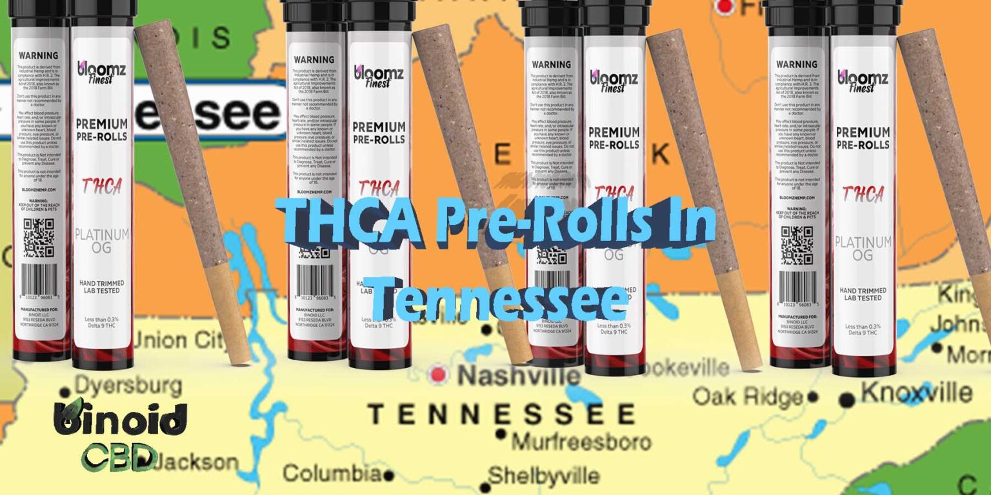
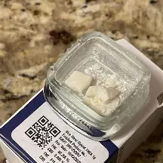
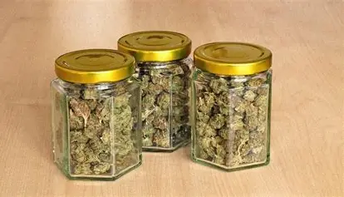
QR Code
Quick-Response Code
QR Codes that pull up the COA when scanned are commonly found labeled on retail-ready products
NO QR CODE = OUT OF COMPLIANCE
2025 TABC Webinar How to Read a COA

Slide 5

Who issues a COA?
ISO17025 accredited laboratory
Registered with the ABC
2025 TABC Webinar How to Read a COA

Slide 6
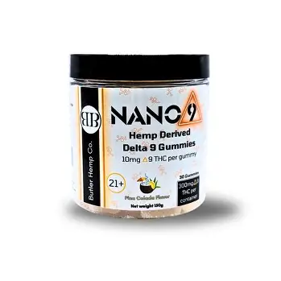
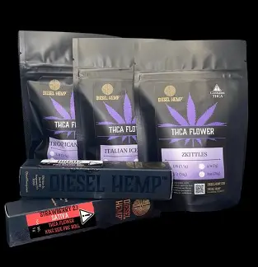
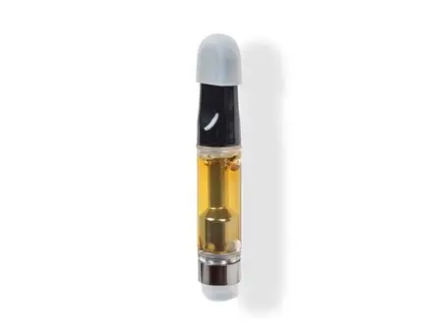
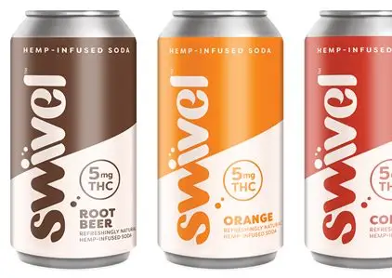
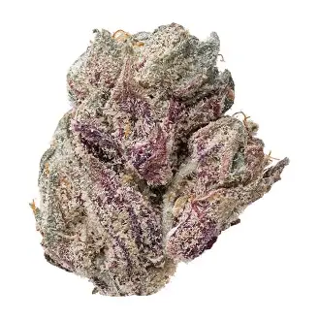
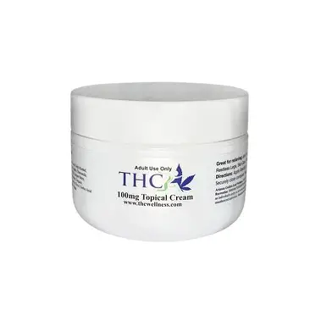
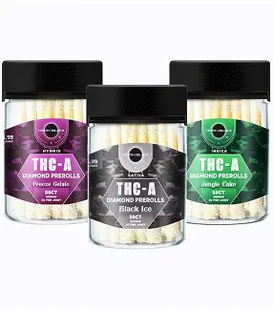
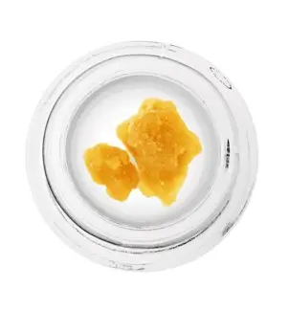
All HDCPs Require a COA – NO EXCEPTIONS
2025 TABC Webinar How to Read a COA

Slide 7
Required Information on Issued COAs for HDCPs
2025 TABC Webinar How to Read a COA

Slide 8
Required Information on Issued COAs for HDCPs
2025 TABC Webinar How to Read a COA

Slide 9
Core Components of a COA
Sample Information: Photo, sample ID, lot / batch #, date of the analysis
Lot / Batch #: Corresponds with the sample number on the report.
Laboratory: name, address, contact info, certification, testing methods, results
Supplier / Manuf: The product manufacturer's name and address.
Full Panel Results (potency, heavy metals, micro, pesticides, residual solvents)
Authorized signature of laboratory director / manager / representative
LOD / LOQ for every analyte
2025 TABC Webinar How to Read a COA

Slide 10
HOW TO ENSURE THE COA IS COMPLIANT
INCLUDES ALL REQUIRED TESTS
SAFETY AND POTENCY TESTING
MANUFACTURER INFORMATION
SAMPLE INFORMATION
LABORATORY INFORMATION
2025 TABC Webinar How to Read a COA

Slide 11
RESULTS - SECTIONS
Potency
Microbiological
Heavy Metals
Residual Solvents
Pesticides
2025 TABC Webinar How to Read a COA

Slide 12
SAMPLE INFORMATION
Client Name is where you’ll find the information re: supplier / manufacturer
Batch/Sample ID is a unique set of numbers and/or letters that identifies the specific product sample being tested.
Received Date is the date that the sample was collected for testing.
Sample Name refers to what kind of HDCP is being tested.
Sample Type refers to the final product form (e.g. pre-rolls, lozenges, chews or flower) of the HDCP being tested.
Received Date is the date the lab received the product sample for testing.
Completed Date is the date the CoA was created and reported.
2025 TABC Webinar How to Read a COA

Slide 13
POTENCY RESULTS
Analyte – specific compounds which were tested that are mentioned on the products packaging or label
LOD /LOQ – smallest amount or concentration of a substance that can be determined accurately
Testing Method – the type of method of analysis that was applied. In this example we see the potency analysis was conducted via HPLC.
2025 TABC Webinar How to Read a COA

Slide 14
Heavy Metals / Pesticides Testing
Lab testing results for detection of heavy metals & pesticides. For each analyte you will see the result plus the LIMIT. This means the concentration of any given contaminant that is allowed to be present.
2025 TABC Webinar How to Read a COA

Slide 15
Residual Solvent Screening
During extraction, solvents such as ethanol, butane, and propane are often used to separate active compounds from the plant material. If not fully removed, these solvents can remain in the final product and pose health risks to consumers.
2025 TABC Webinar How to Read a COA

Slide 16
Microbiological Results
2025 TABC Webinar How to Read a COA

Slide 17
SITUATIONS OF CONCERN
QR codes on packaging should NOT link to a brand's website
The product you are holding does not represent the photo in the COA
QR code leads to a google drive with more than one COA
No watermark on the COA
Missing supplier / manuf information
Redacted information / potency only but no safety screens
Visible differences in font
QR does not resolve
Missing contact information for the lab
2025 TABC Webinar How to Read a COA

